Slide 1
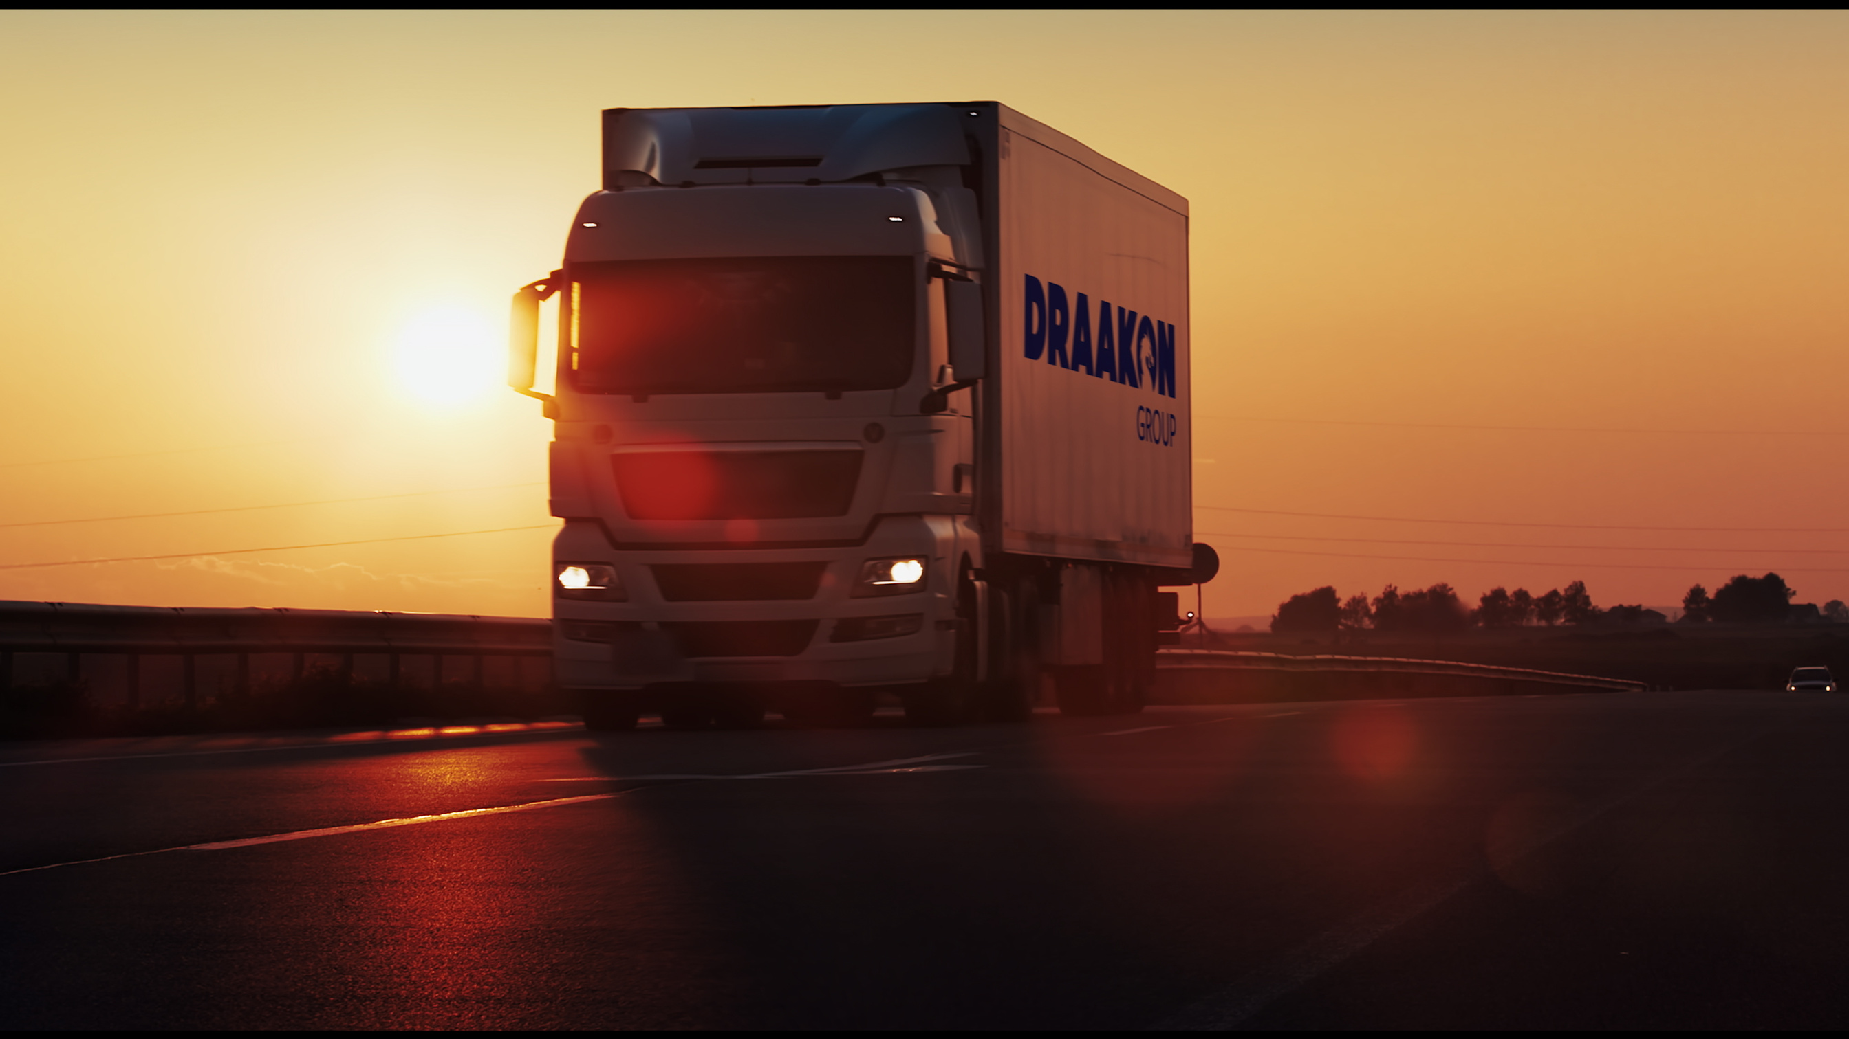

www.draakon.com.tr

Slide 2
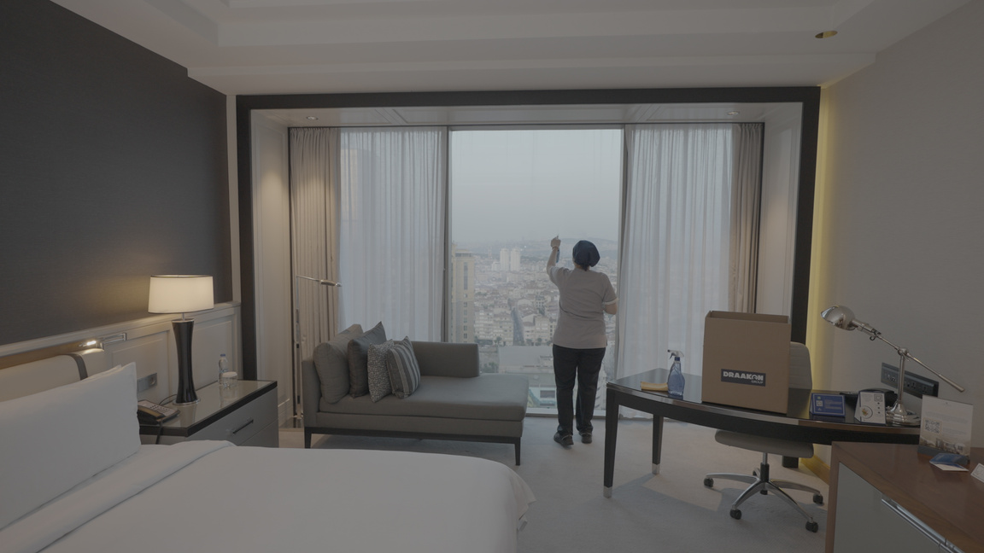
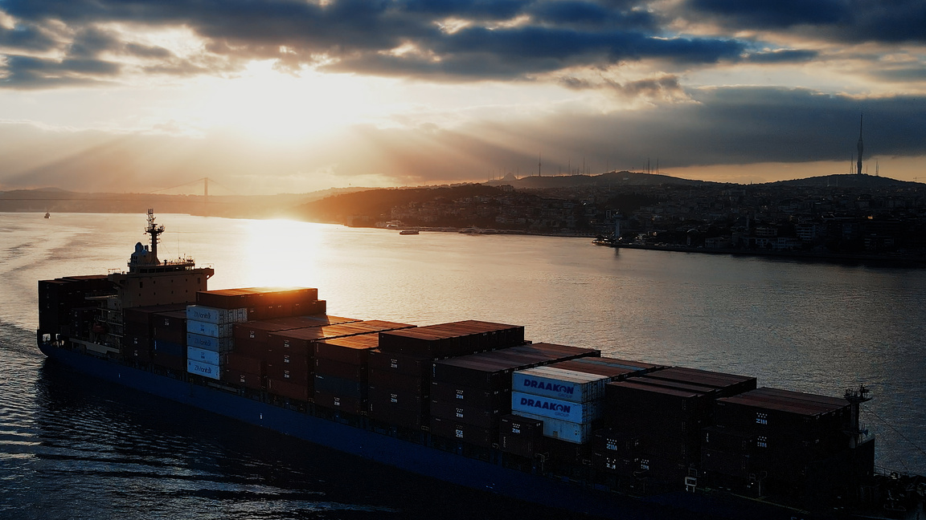
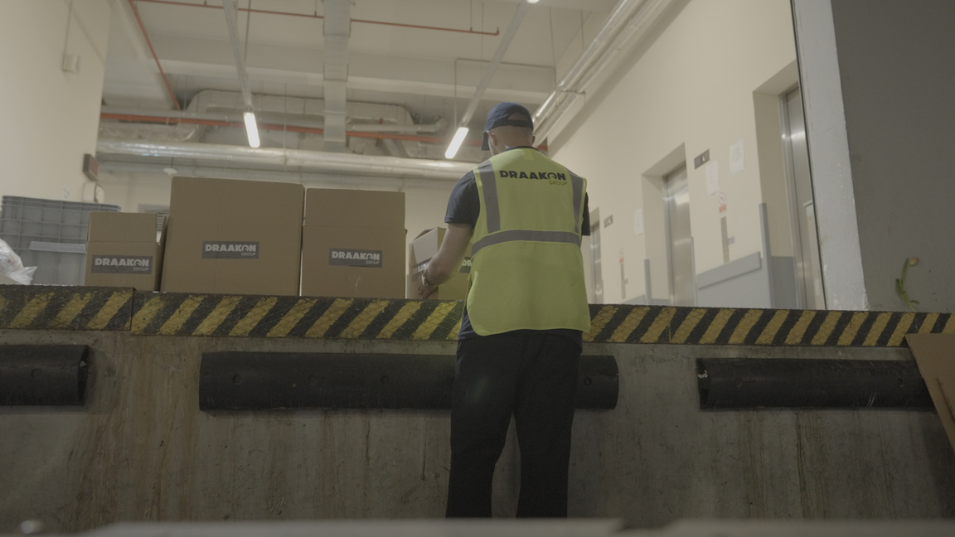
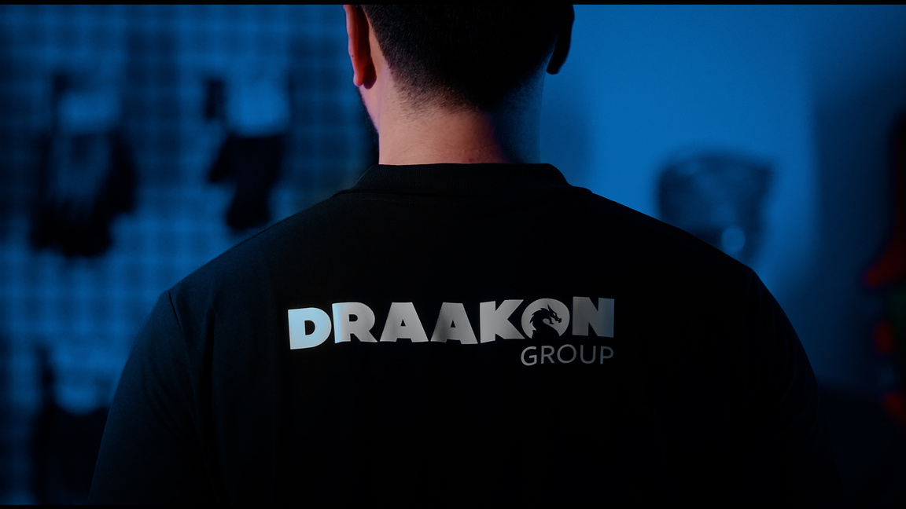

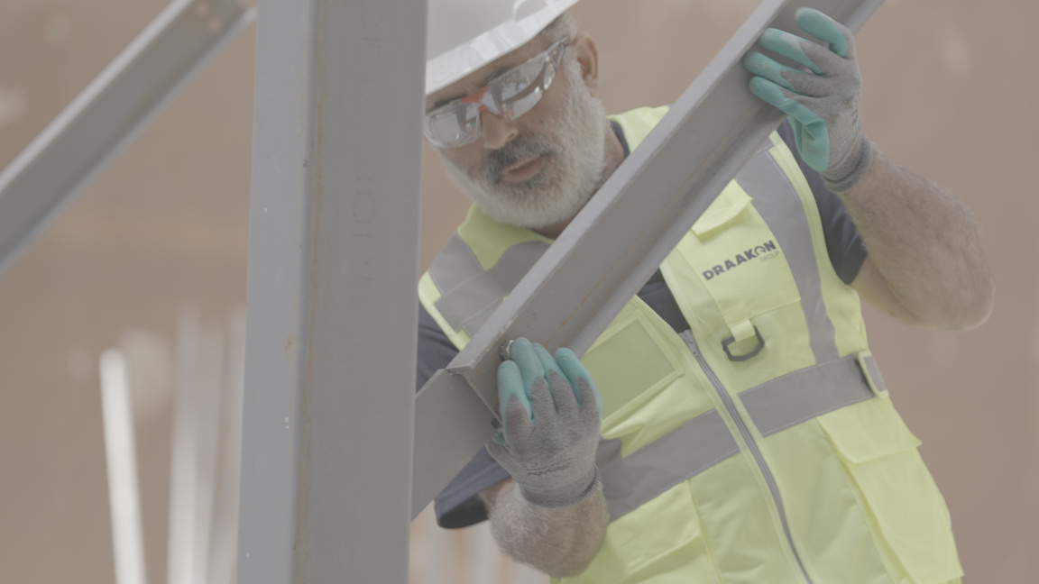
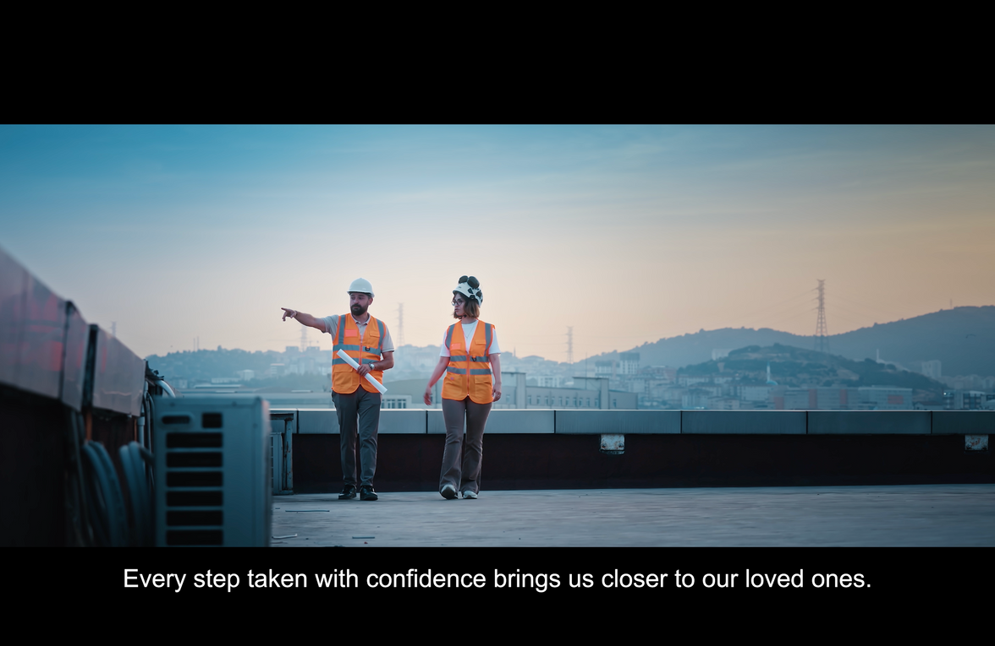
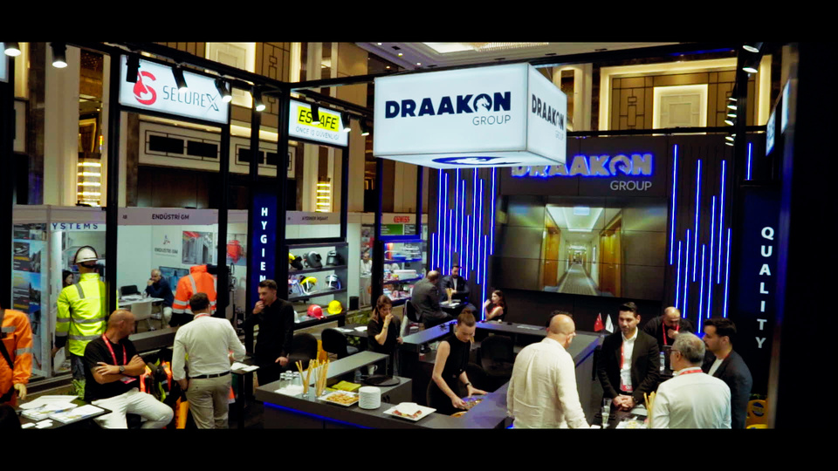
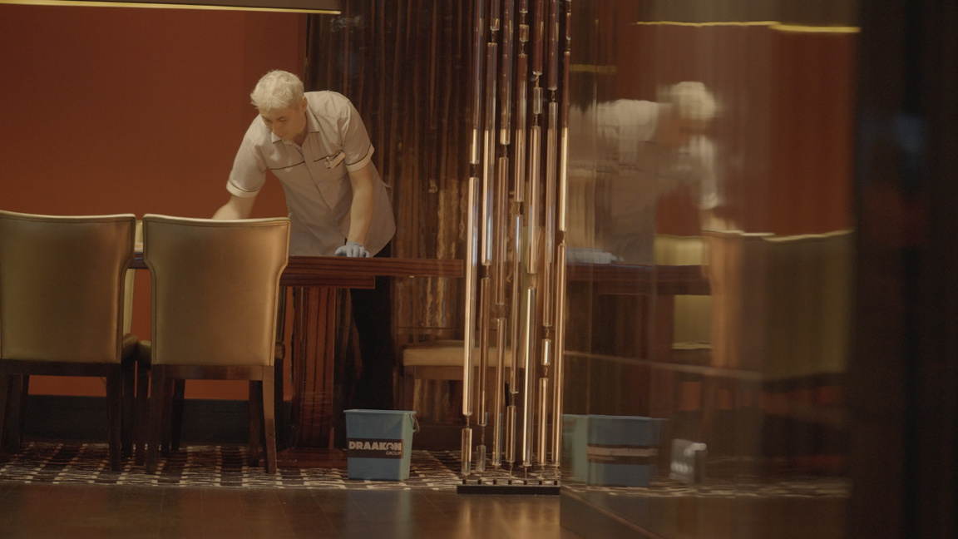

Slide 3


DRAAKON
Draakon Group continues its operations in various sectors, including Health, Medical, Cleaning, Stationery, Personal Protective Equipment, and Textiles, with domestic and international group companies. It has a management approach that fosters strategic thinking, participation in decision-making processes, respect for people, and a strong sense of social responsibility.
Draakon Group,
"Quality is trust, and trust is the foundation of customer satisfaction."
Draakon Group, always prioritizing quality and customer satisfaction in its operations, proceeds with a strategy focused on sustainable growth, maintaining this policy without compromise and upholding its standards.
This growth is aligned with the incorporation of advancements and aims to deliver the best service or product in parallel with the overall development of the sectors.
Our company has a strong performance history, demonstrating a remarkable workforce in both corporate and private projects.
Operating in the category of brand companies, Draakon Inc. holds the distribution and dealership rights of some of the most valuable and powerful brands in its portfolio.
Our goal is to expand our network by adding valuable new customers, meeting their demands and needs, and broadening our market.
www.draakon.com.tr
Notes:
3

Slide 4
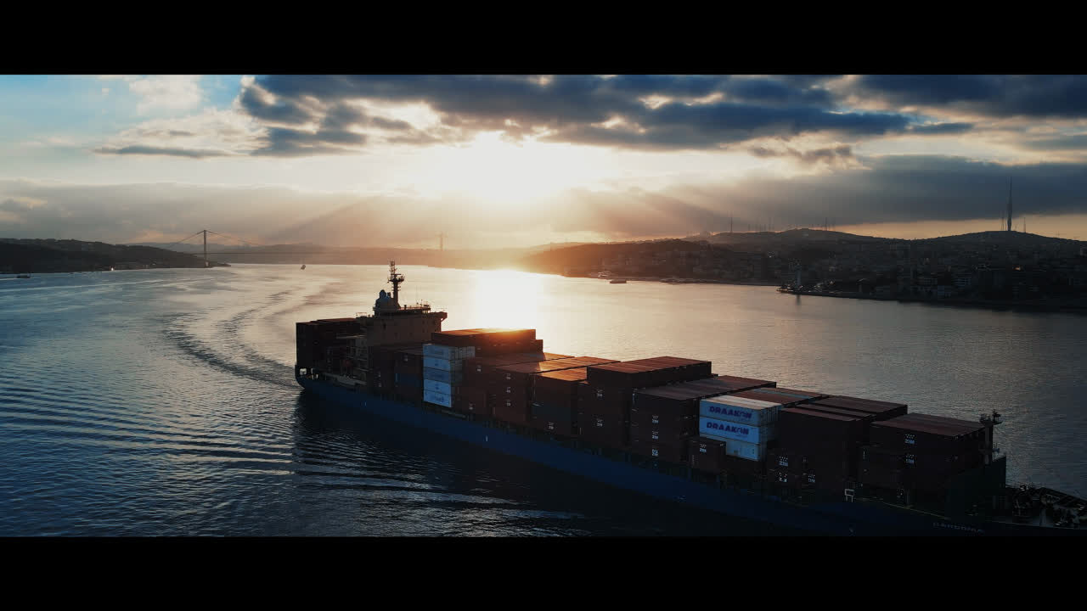

Slide 5
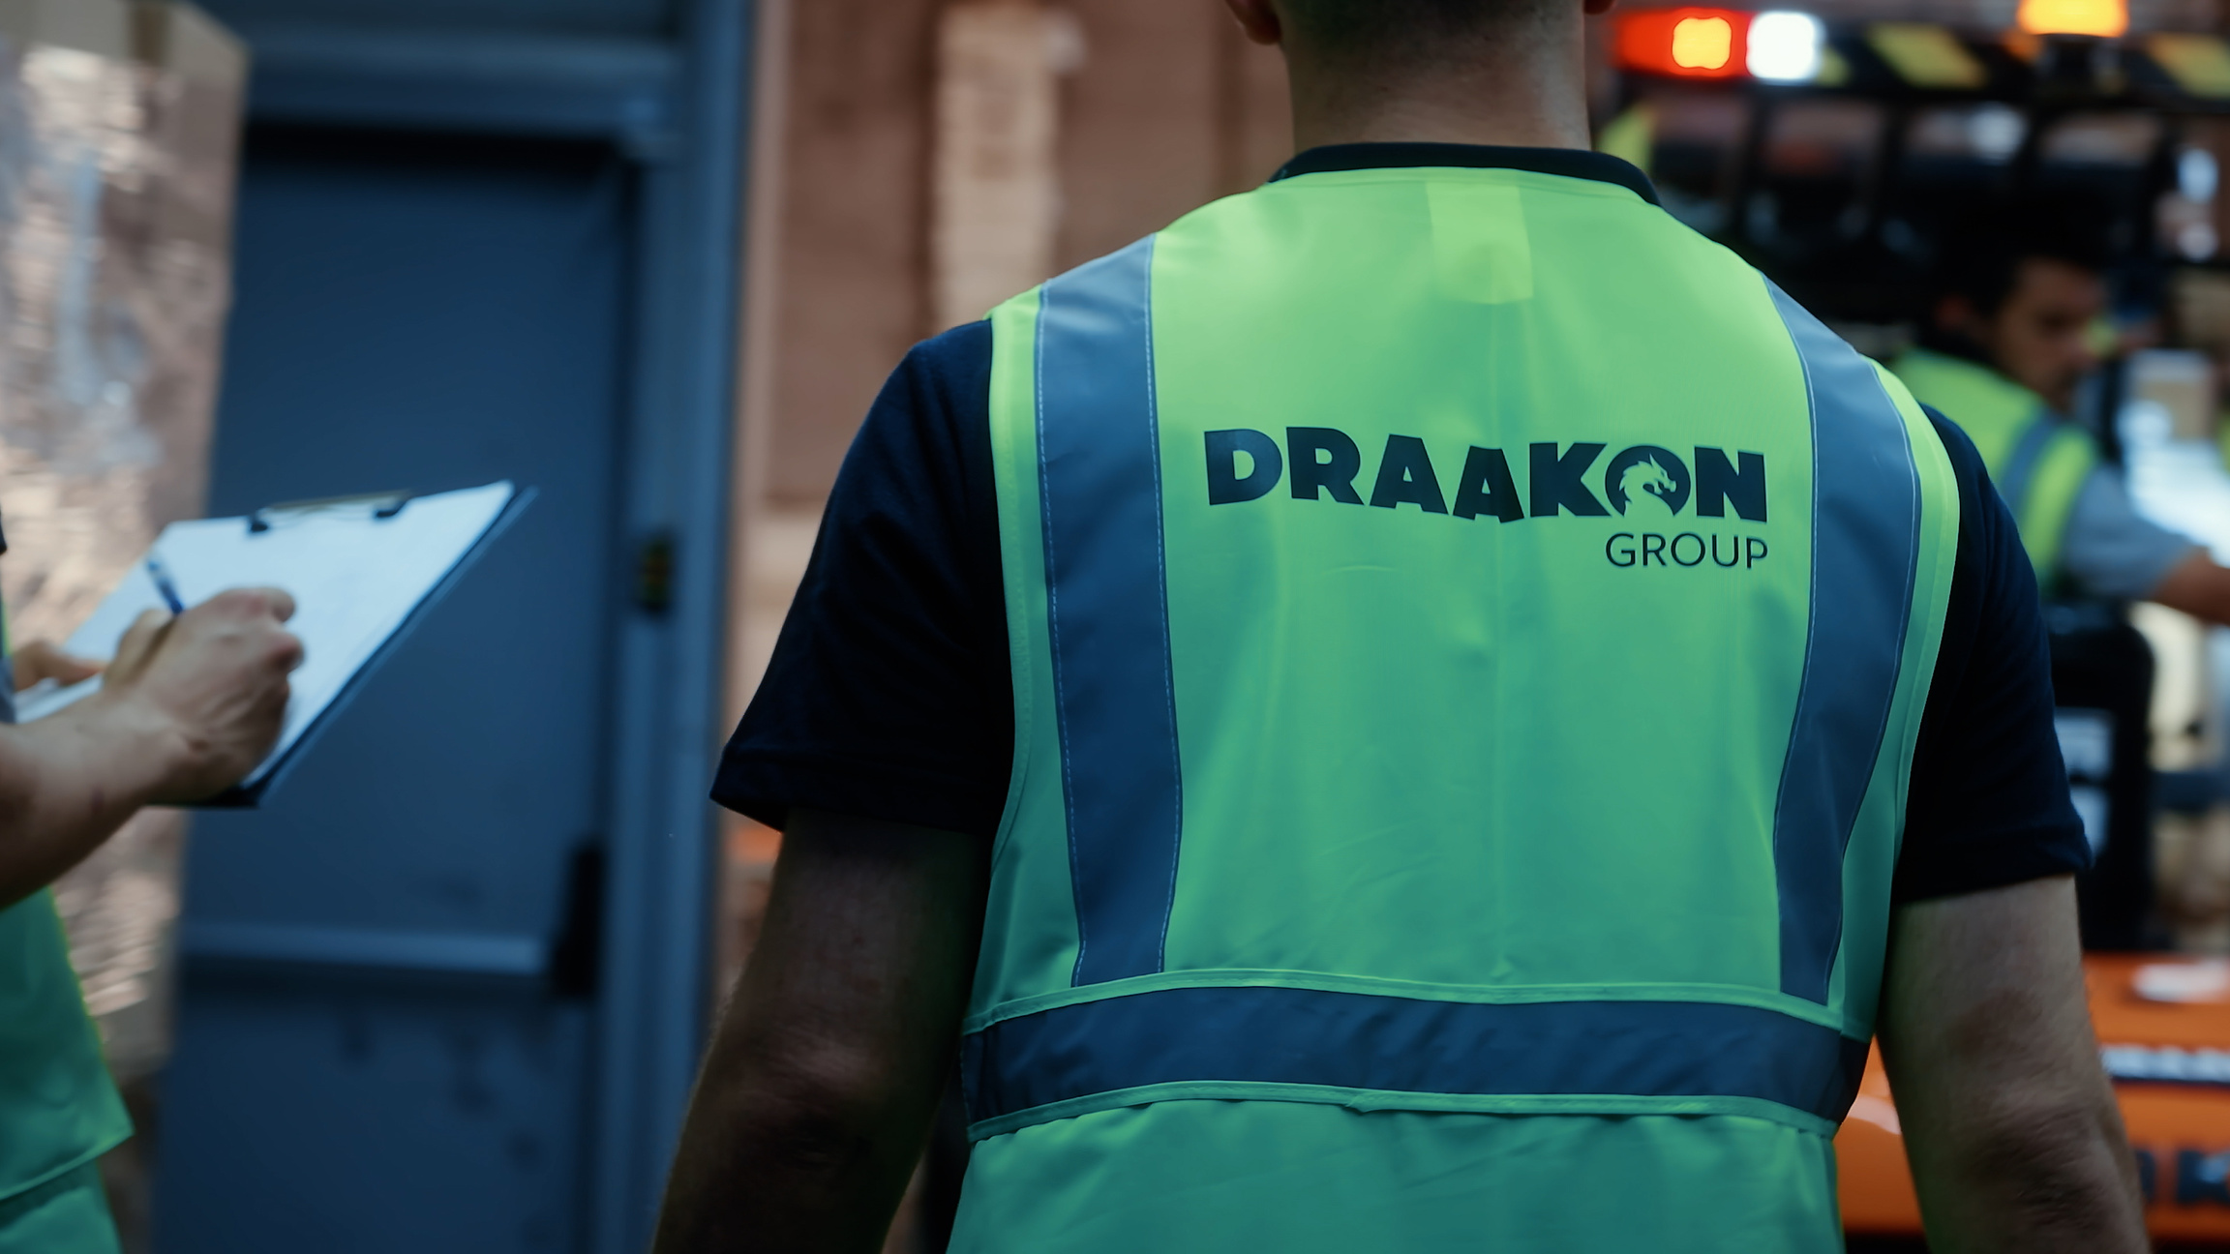

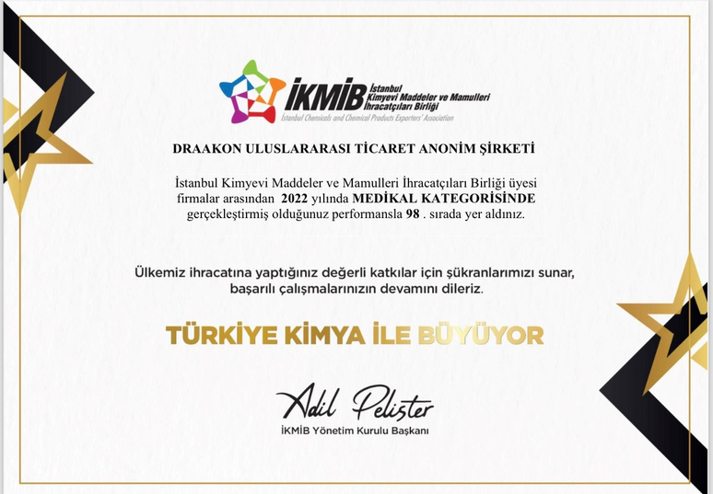





Why DRAAKON GROUP ?
Strategic Location
Competitive Advantage
Operational Flexibility
Cost Planning Team
Product Variety
Order Management
You can find all the essentials for your business here.
We are in
the top 100
medical exports!
Shipping and Logistics
Safe Delivery

Slide 6








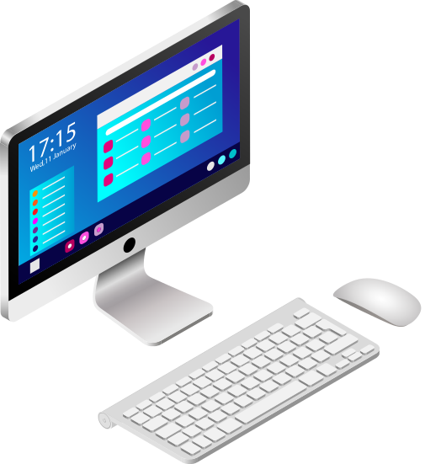
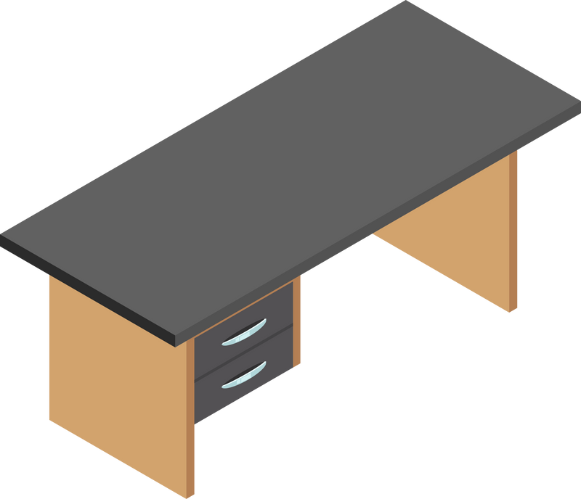


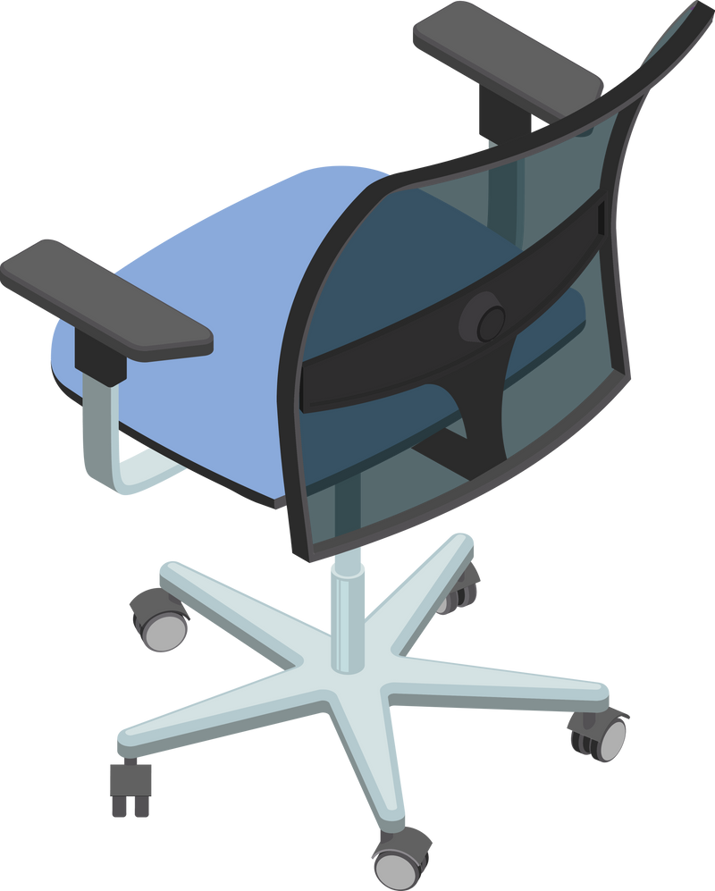


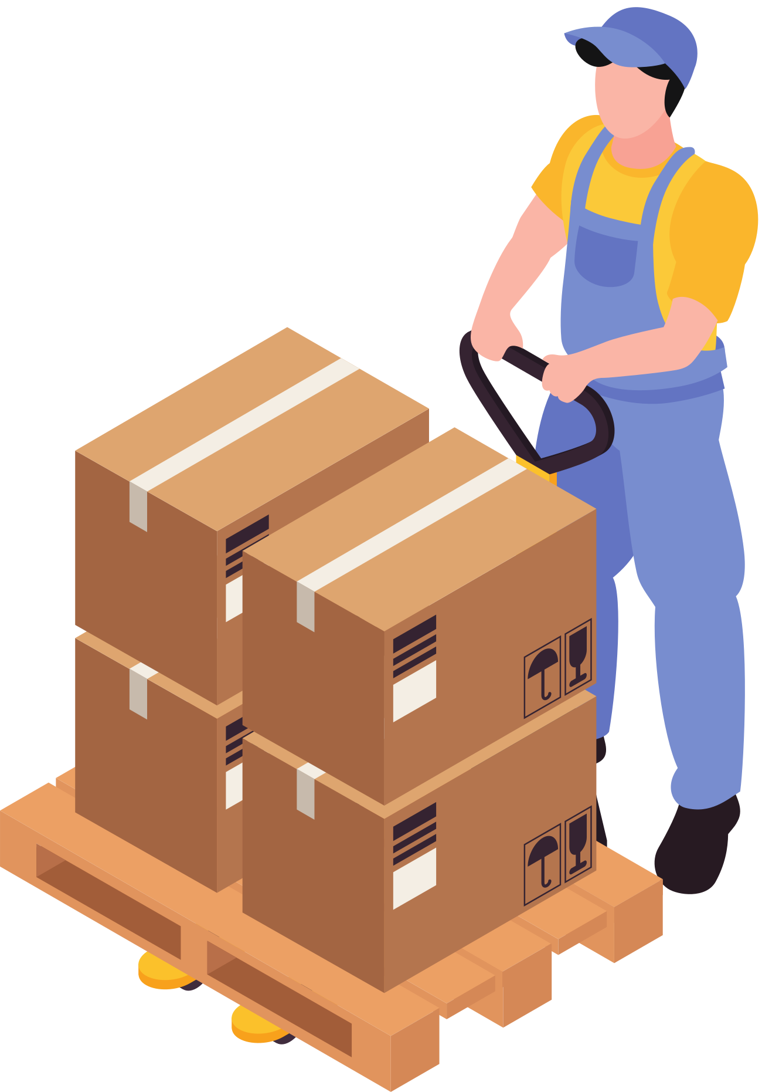

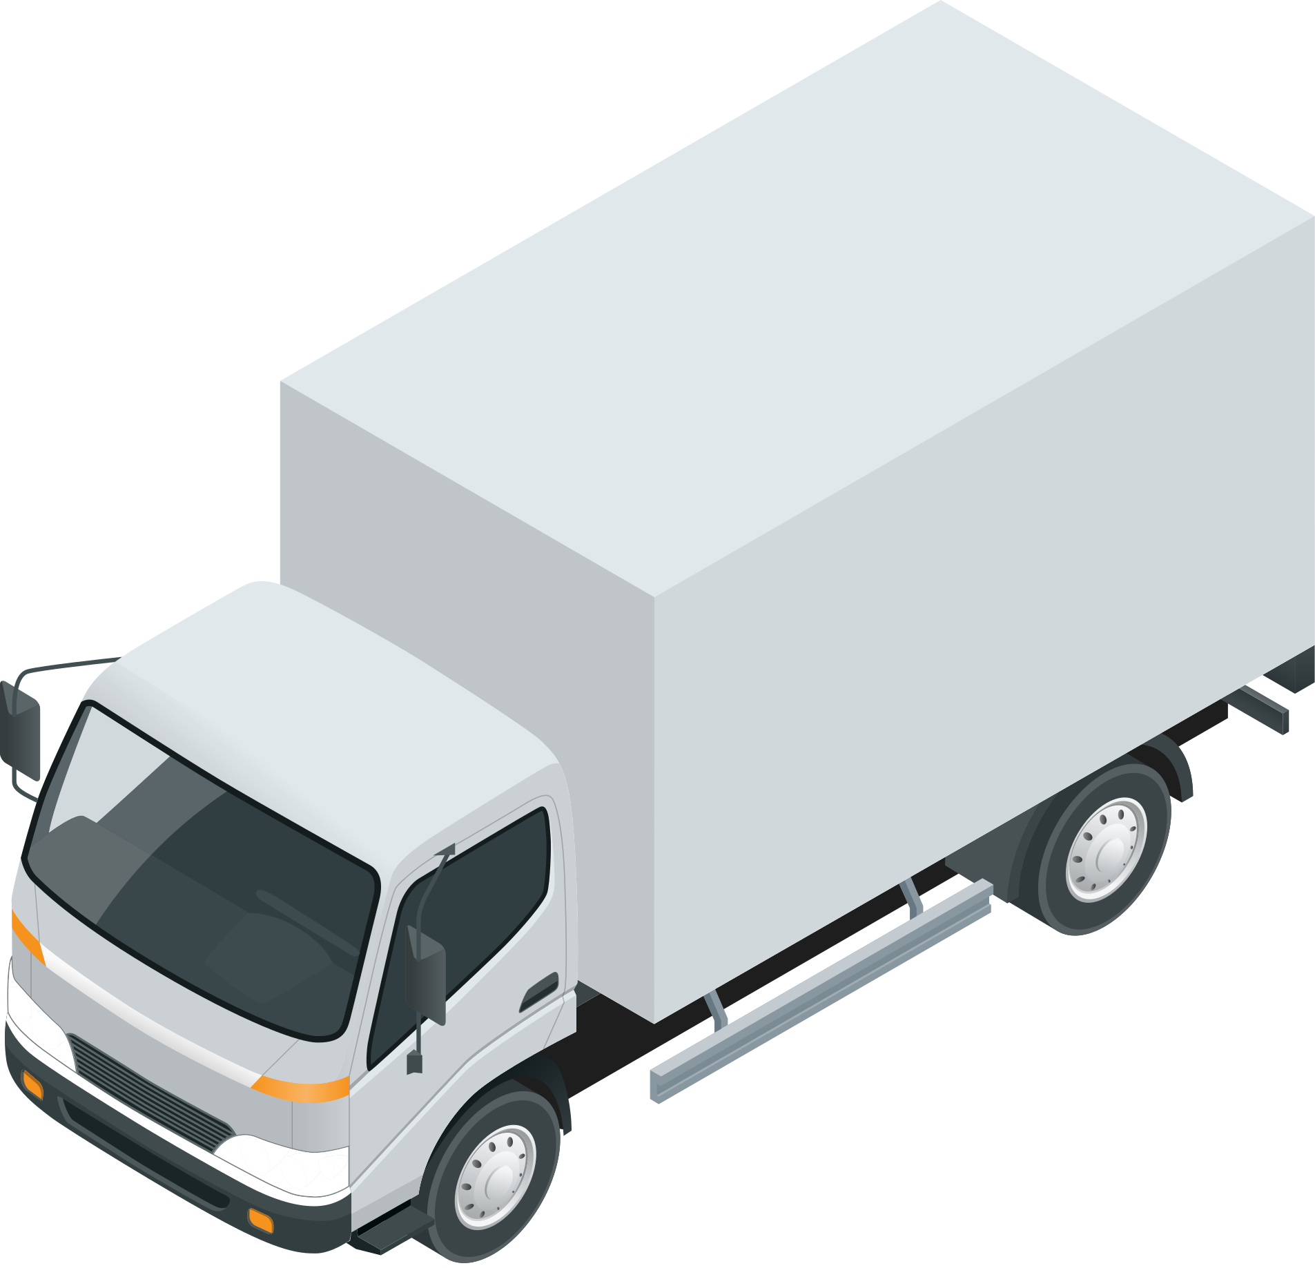

We get to know you and identify your needs.
We prepare your quotation and approval processes.
Healthcare Institutions
Projects
Factories
Educational Institutions
Restaurants
Offices
Cafes
Hotels
Our Team Information
Our Fleet Information
3 contracted logistics companies
3 shipment vehicles
2 micro distribution vehicles
1 operations support vehicle
2-person field sales team
4-person key account team
3-person sales support team
2-person operations team
16-person office & warehouse team

Slide 7


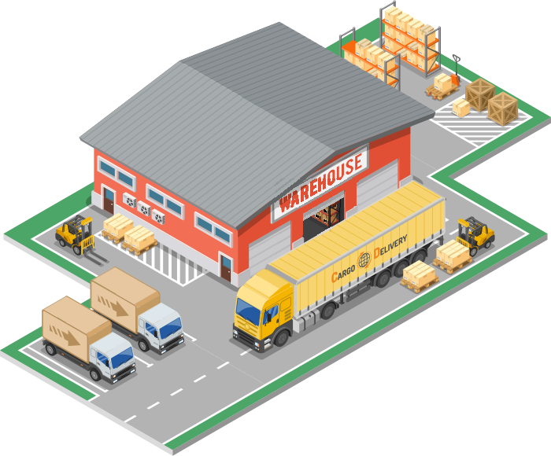
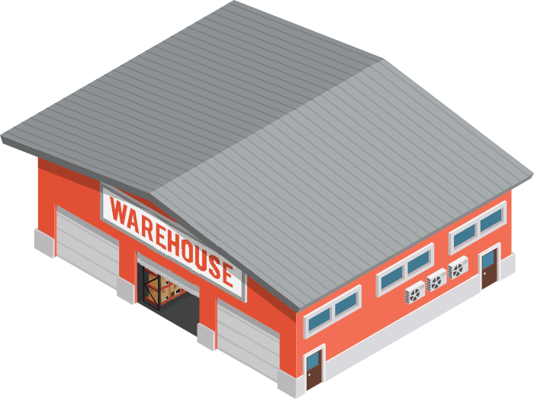
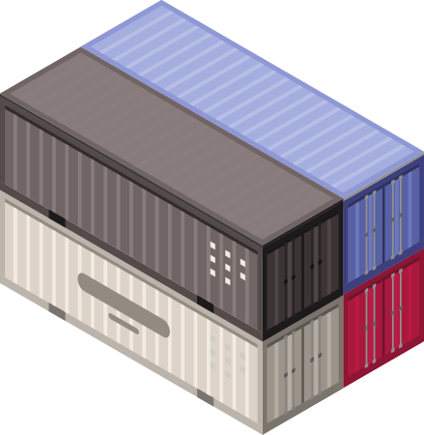
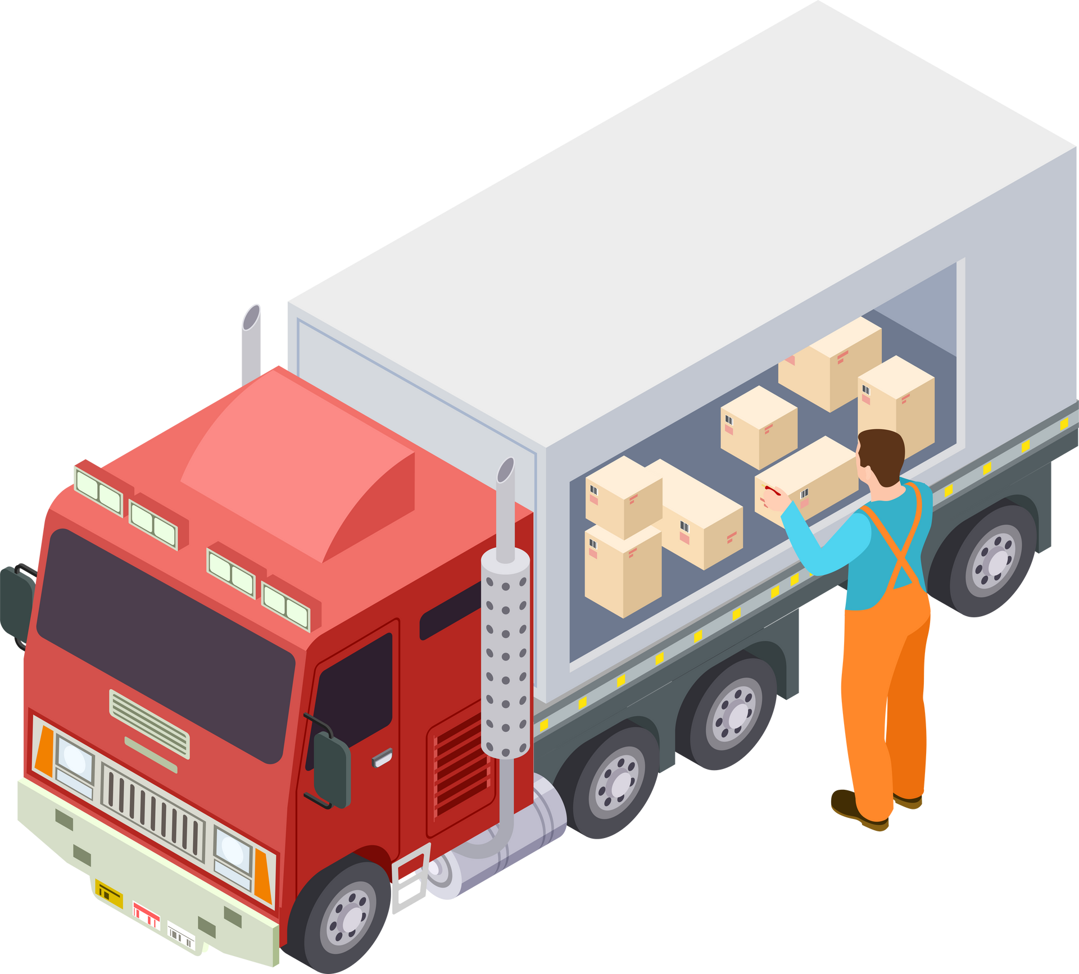
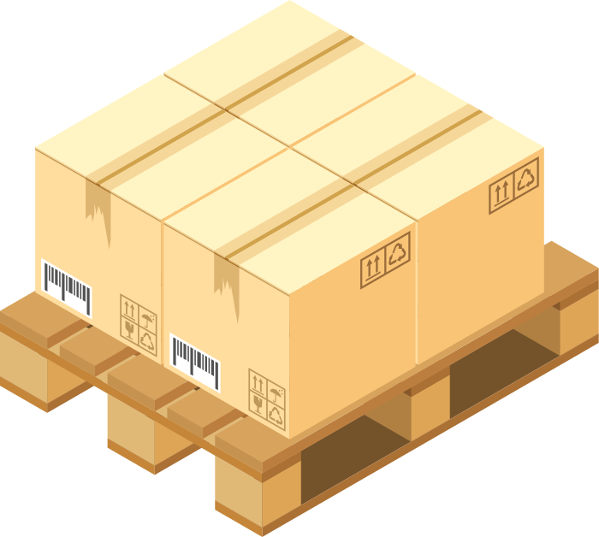
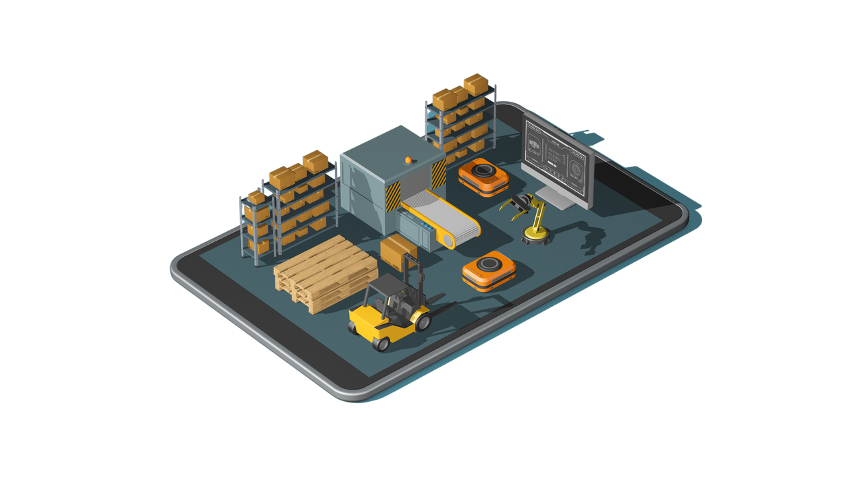
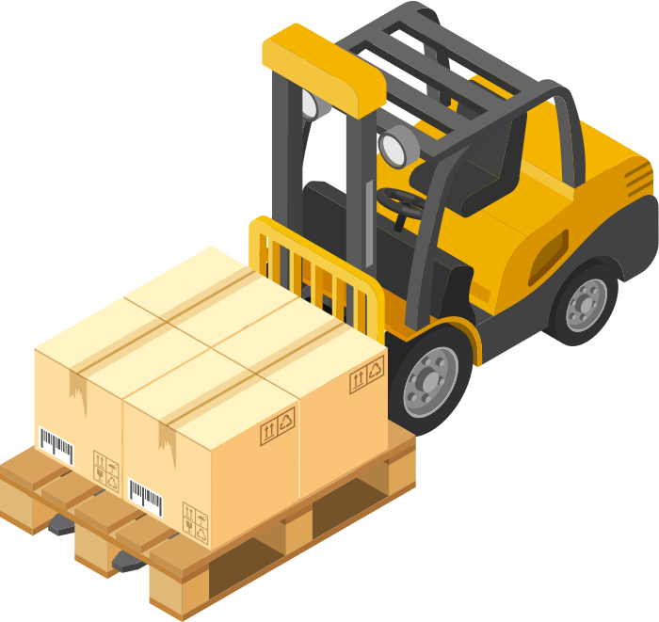
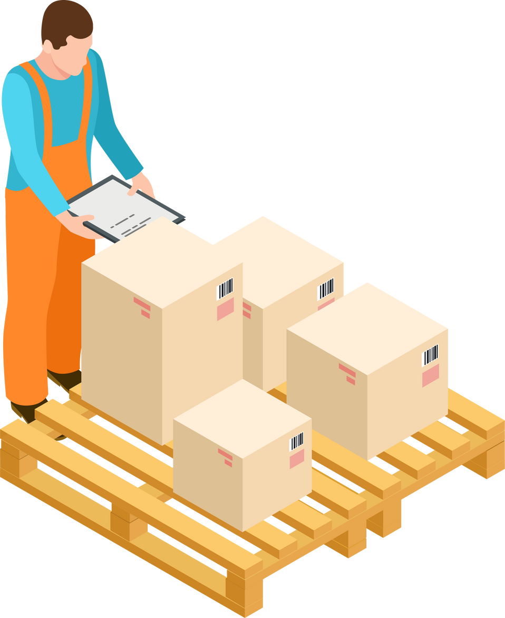

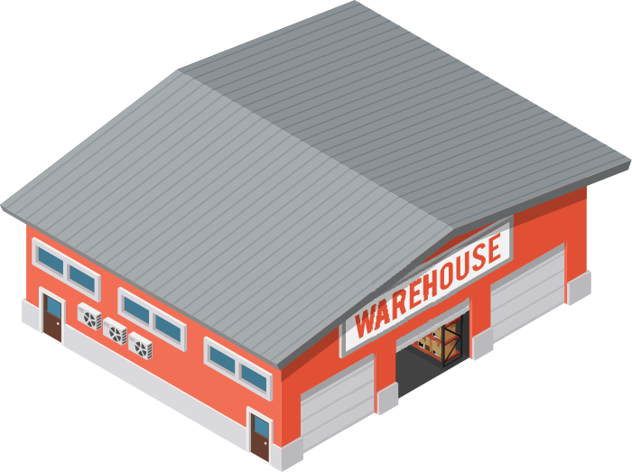

We store for you
We deliver on time for you
Our Locations
Istanbul Headquarters
Ankara Warehouse
Norway Warehouse

Slide 8
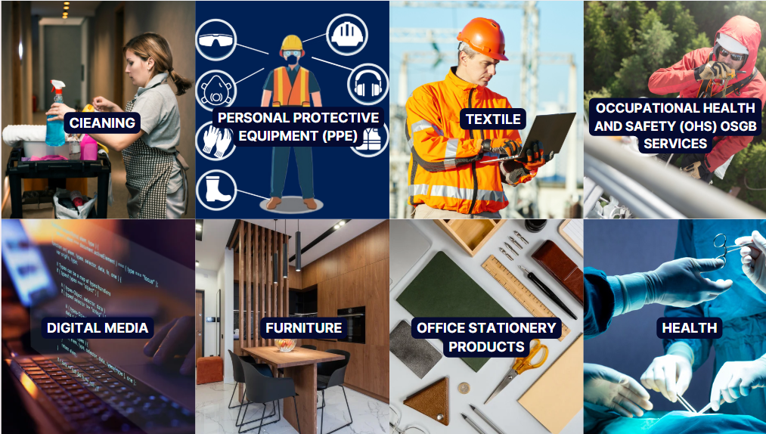
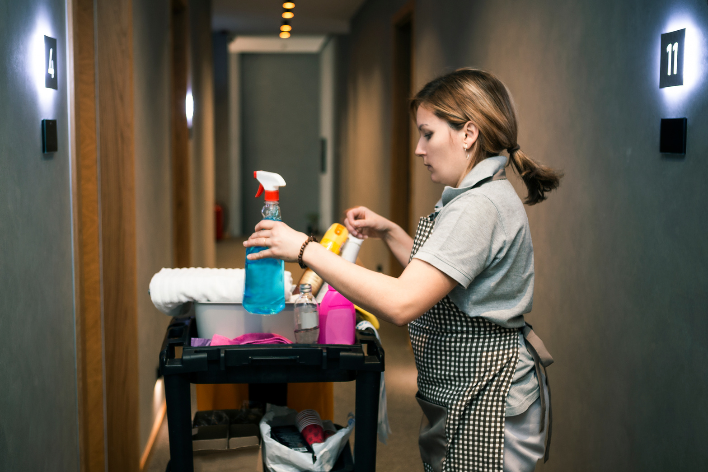
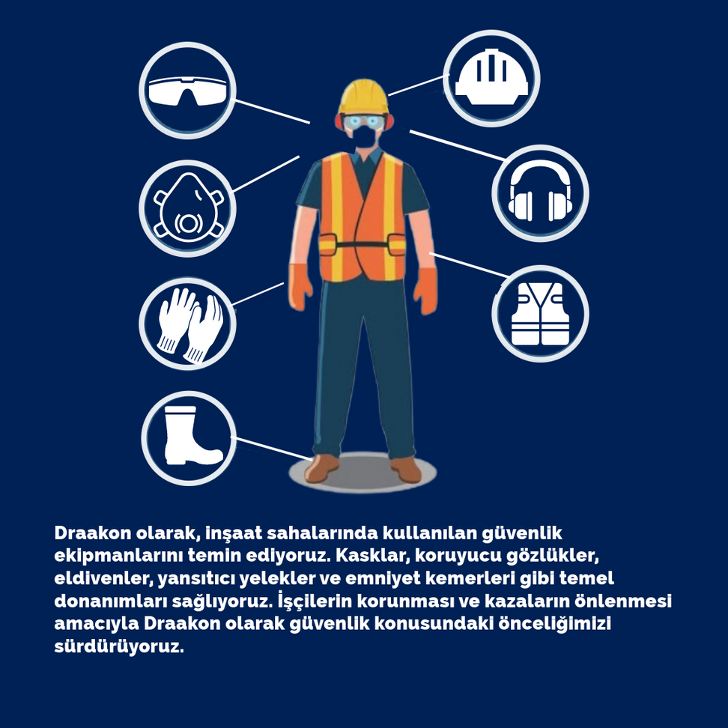

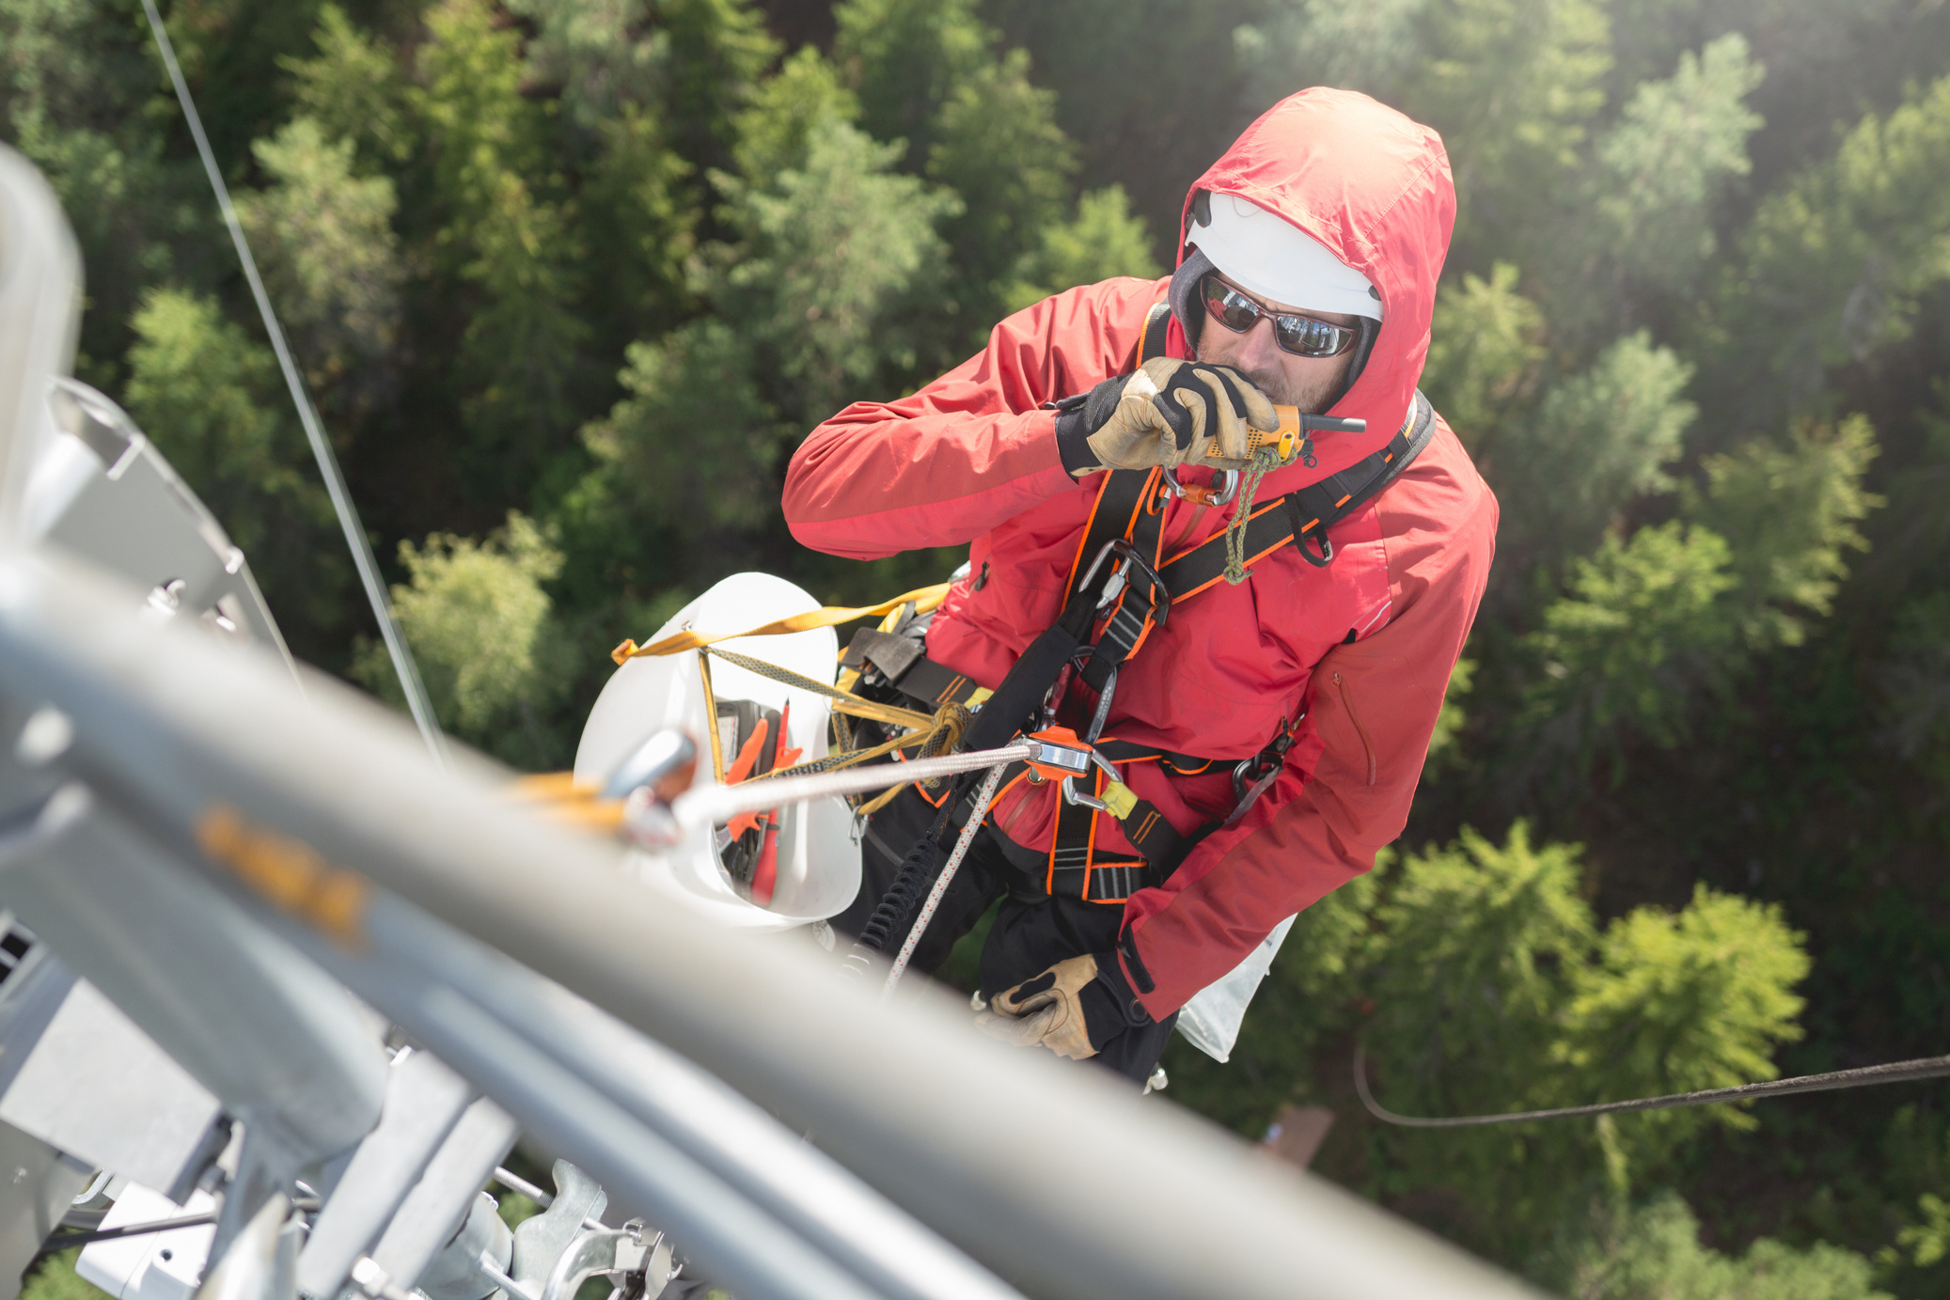

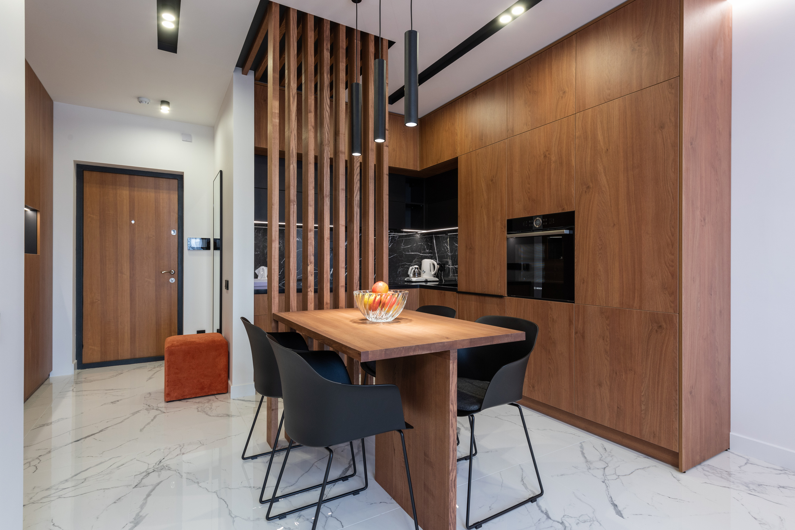


OCCUPATIONAL HEALTH AND SAFETY (OHS) OSGB SERVICES
ClEANING
PERSONAL PROTECTIVE EQUIPMENT (PPE)
TEXTILE
DIGITAL MEDIA
FURNITURE
OFFICE STATIONERY PRODUCTS
HEALTH

Slide 9
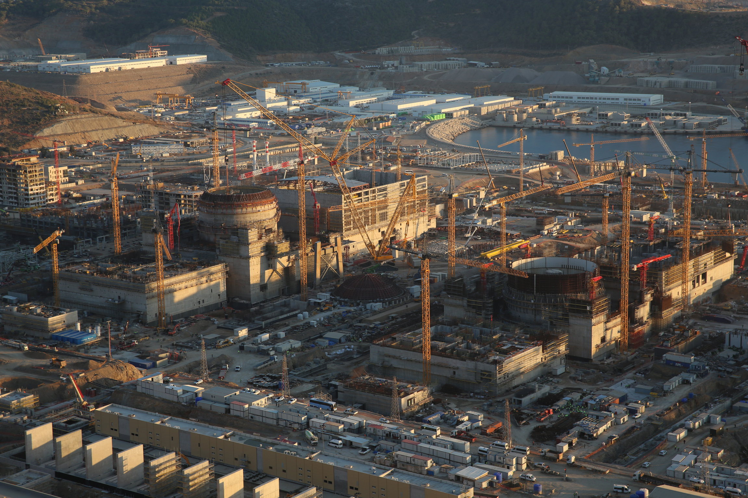
SPECIALIZED SOLUTION!
Akkuyu Nuclear Power Plant
We are the contracted Main Supplier of the project, which employs 30,000 personnel.

Slide 10
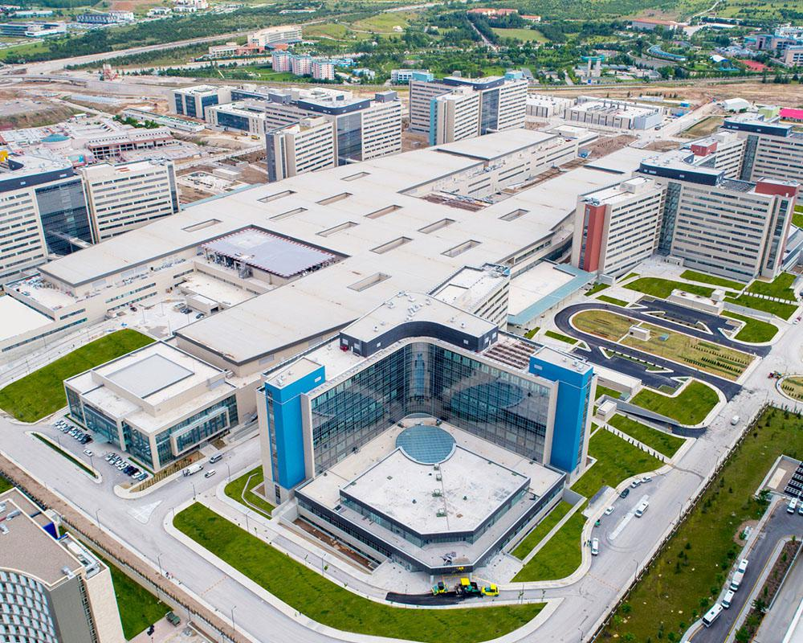
By switching from Z-fold towels to inner pull paper, we achieved a 7% monthly cost savings.
SPECIALIZED SOLUTION!
Ankara City Hospital
By switching from Z-fold towels to inner pull paper, we achieved a 7% monthly cost savings.

Slide 11
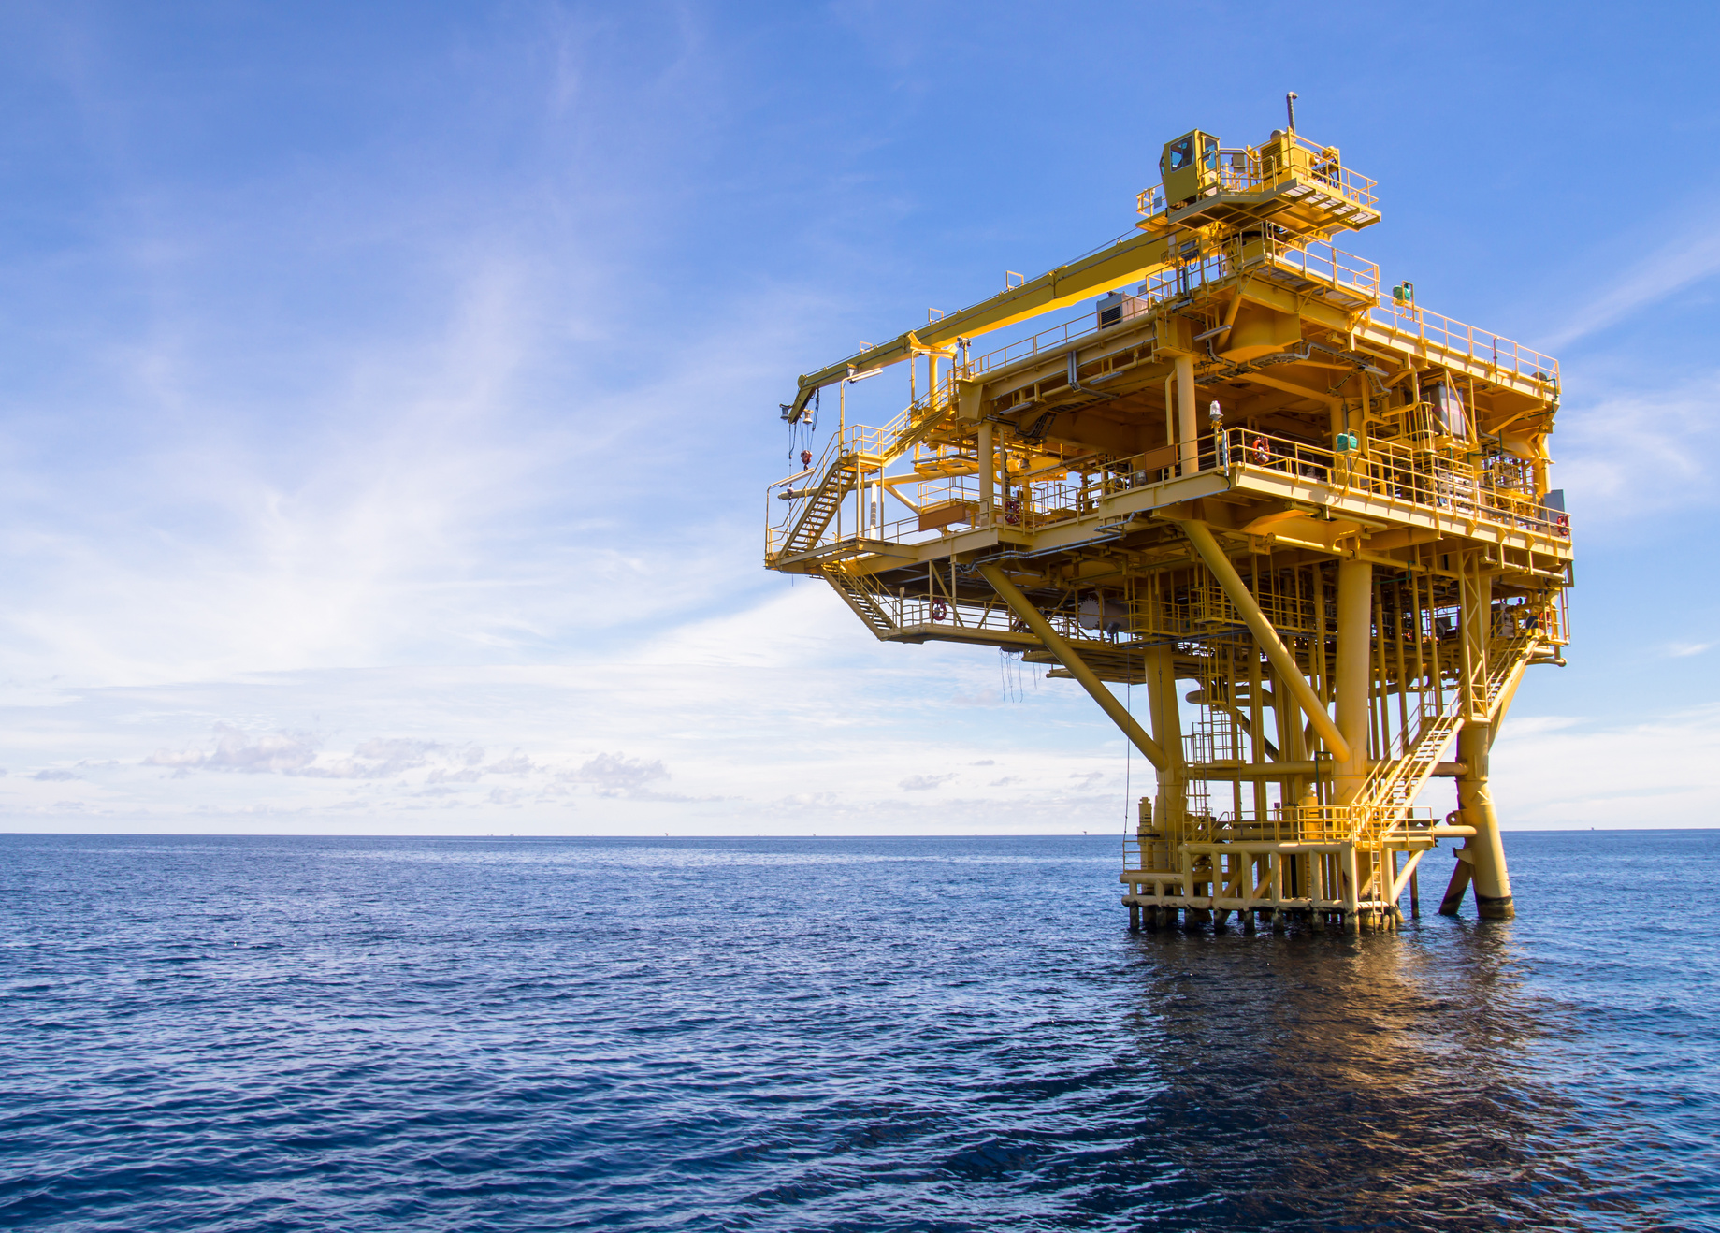
SPECIALIZED SOLUTION!
Black Sea Natural Gas Pipeline (SAIPEM)
All the specified technical personal protective equipment for the project has been imported by Draakon International Trade Inc.

Slide 12
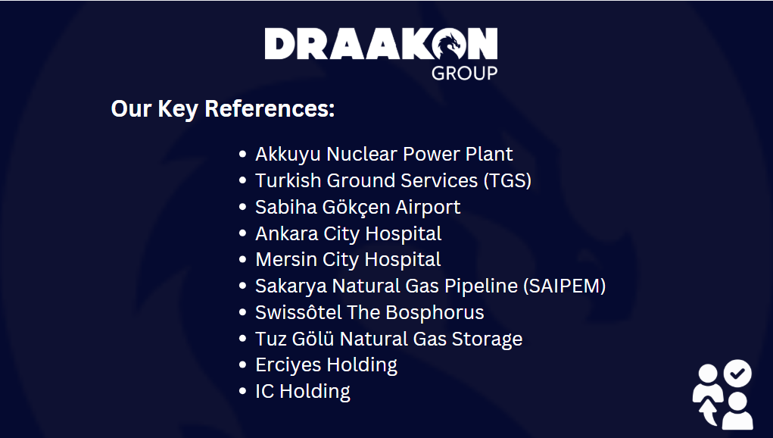

Slide 13
